Slide 1
ED-ME111
L-2
Dr. Poonam Kumari

Slide 2
LETTERING
Writing text on a drawing (e.g. titles, dimensions, scales) using letters which can be alphabets, numerals, symbols or punctuation marks to convey detailed information.
Features of Lettering
Legibility, uniformity, ease, rapidity of execution and reproducibility
No ornamental or artistic and cursive style of letter
Letters should be distinguishable from each other in order to avoid any confusion even in case of slight mutilations
Standard followed
IS 9609 (Part 0): 2001 & SP46: 2003 (lettering for technical drawings). This BIS standard is based on ISO 3098-0: 1997

Slide 3
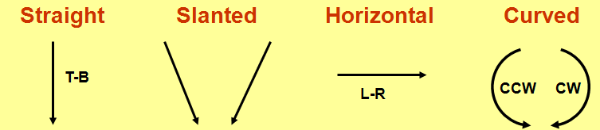
Types of Lettering
Single stroke - Thickness of the line of the letter should be such as is obtained in one stroke of the pencil.
Does not mean that the letter should be made in one stroke without lifting the pencil.
BIS (SP46:2003) - Gives dimensions for lettering & types
Type A - Height of capital letter is divided into 14 parts
Type B – Height of capital letter is divided into 10 parts
Both types can be Vertical or Inclined at 75˚ to the horizontal
Line Width of Type A ˂ Type B
Double stroke- When more thickness is given to single stroke letters, it is known as double stroke or gothic letters.
Basic Strokes

Slide 4
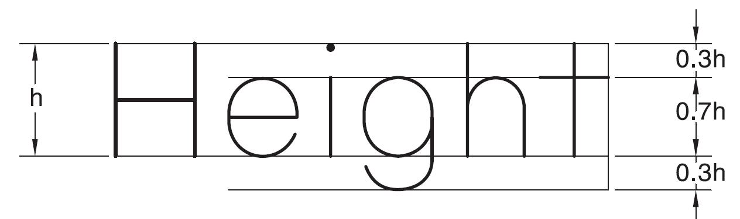
Height and width of letters
Examples
“I” letter
“A” letter
BIS (SP 46: 2003) has recommended the heights of letters as: 1.8, 2.5, 3.5, 5, 7, 10, 14 & 20 mm
“B” letter
4
5
1
1
2
1
Sl. no | Items on a drawing | Size (mm)
1 | Name of the company | 10, 14, 20
2 | Drawing numbers, letters denoting section planes | 10,14
3 | Title of the drawing | 7, 10
4 | Sub- titles & Headings | 5, 7
5 | Dimensioning, notes, schedules & material lists | 3.5, 7
6 | Alteration entries and tolerances | 3.5
3
6
3
2
.
Total height of lowercase letters equals that of capital letters.
The height-to-width ratio for letters varies between 7 : 5 or 7 : 6

Slide 5
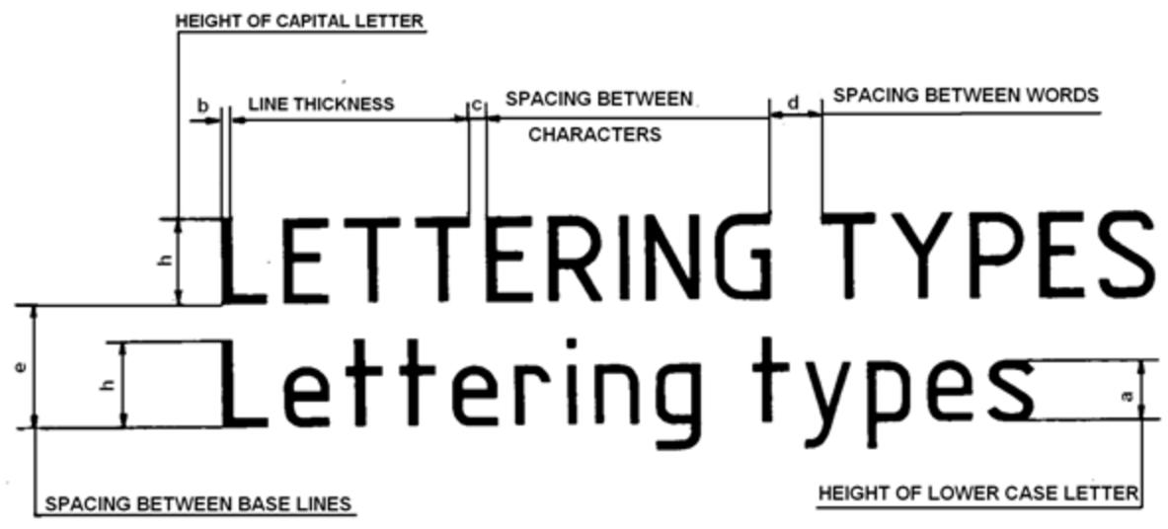
A & B type
Lettering
BIS (SP46: 2003)
Specifications | Type | Value | Size (mm)
Capital letter height | A | h | 2.5 | 3.5 | 5 | 7 | 10 | 14 | 20
 | B | h | 2.5 | 3.5 | 5 | 7 | 10 | 14 | 20
Lowercase letter height | A | a=(5/7)h | - | 2.5 | 3.5 | 5 | 7 | 10 | 14
 | B | a=(7/10)h | - | 2.5 | 3.5 | 5 | 7 | 10 | 14
Thickness of lines | A | b=(1/14)h | .18 | .25 | .35 | .5 | .7 | 1 | 1.4
 | B | b=(1/10)h | .25 | .35 | .5 | .7 | 1 | 1.4 | 2
Spacing between characters | A | c=(1/7)h | .35 | .5 | .7 | 1 | 1.4 | 2 | 2.8
 | B | c=(1/5)h | .5 | .7 | 1 | 1.4 | 2 | 2.8 | 4
Minimum spacing between words | A | d=(3/7)h | 1.05 | 1.5 | 2.1 | 3 | 4.2 | 6 | 8.4
 | B | d=(3/5)h | 1.5 | 2.1 | 3 | 4.2 | 6 | 8.4 | 12
Minimum spacing between baselines | A | e=(10/7)h | 3.5 | 5 | 7 | 10 | 14 | 20 | 28
 | B | e=(7/5)h | 3.5 | 5 | 7 | 10 | 14 | 20 | 28

Slide 6
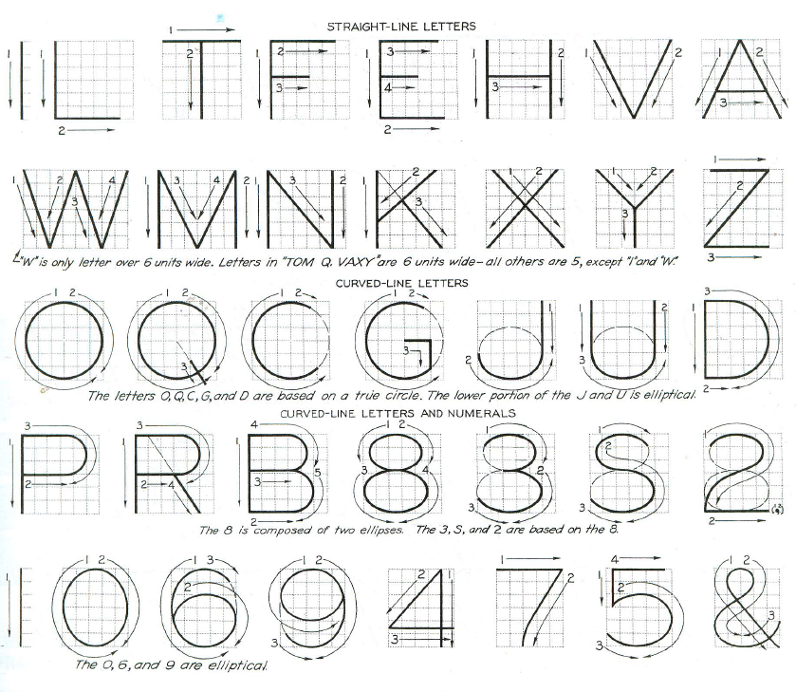
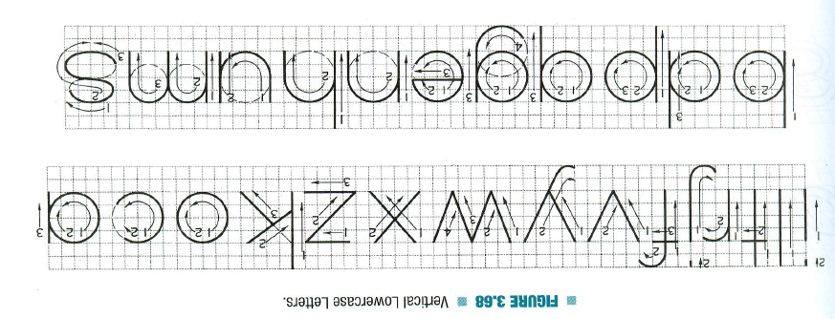
Vertical Capital Letters and Numerical
Vertical Lowercase Letters

Slide 7
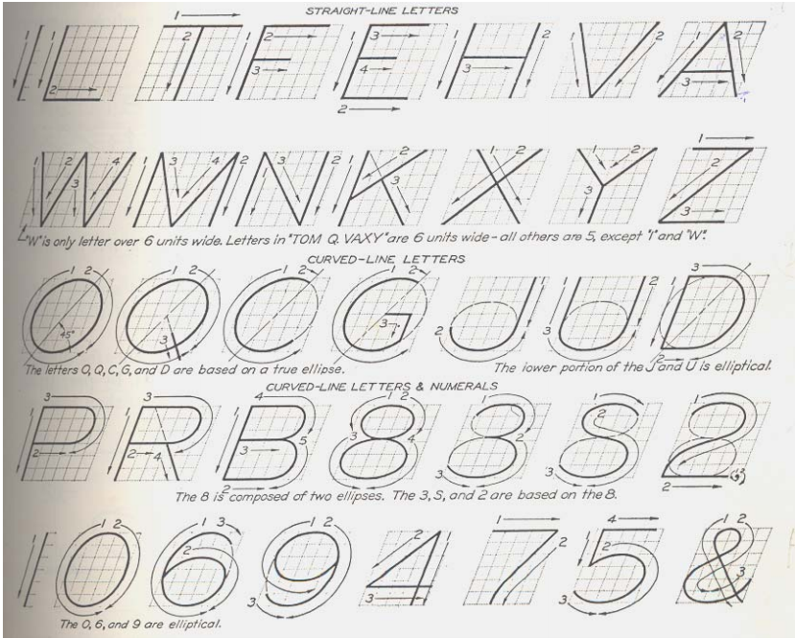
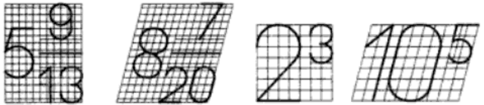
Fraction & Indices lettering
Height of numerator and denominator = 3/4th of height of non-fractioned number
Spacing between division bar and numerator or denominator should be such that the total height of fraction will be twice of that of non-fractioned number
Inclined Capital Letters
At 75˚
The height of index is half of height of a base letter

Slide 8
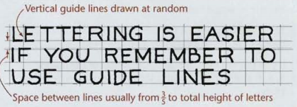
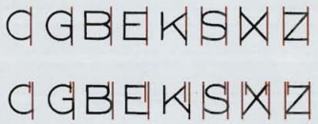
Few Tips
If you put the central horizontal strokes of the letters B, E, F, and H at mid-height, they will appear to be below center. To overcome this optical illusion, draw the strokes B, E, F, and H slightly above the center as you letter, keeping letters uniform, as in the second example of fig(right below).
Use extremely light horizontal guidelines to keep letter height uniform as shown in Figure (left above). Do not use vertical guidelines to space the distance from one letter to the next within a word or sentence . This should he done by eye while lettering.
Some combinations, such as LT and VA, may have to be slightly closer than other letters to look correctly spaced. In some cases the width of a letter may be decreased slightly. In typesetting, pairs of letters that need to be spaced more closely to appear correctly are called kerned pairs.

Slide 9
DIMENSIONING
BIS (SP 46: 2003) defines dimension as a numerical value expressed in appropriate units of measurement and indicated graphically on technical drawings with lines, symbols & notes.
Features of Dimensioning
Units of measurement – length (mm), angles (degrees ˚)
Symbols – incorporated to indicate specific geometries
Notes – to give specification to particular feature or specific information necessary during manufacturing of the job
Elements of Dimensioning
Object lines
Extension lines
Dimension lines
Leader lines
Arrowheads
Dimensions

Slide 10
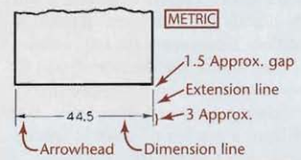
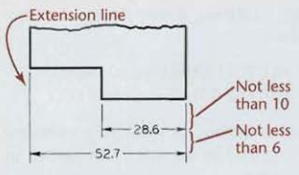
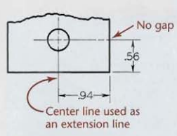
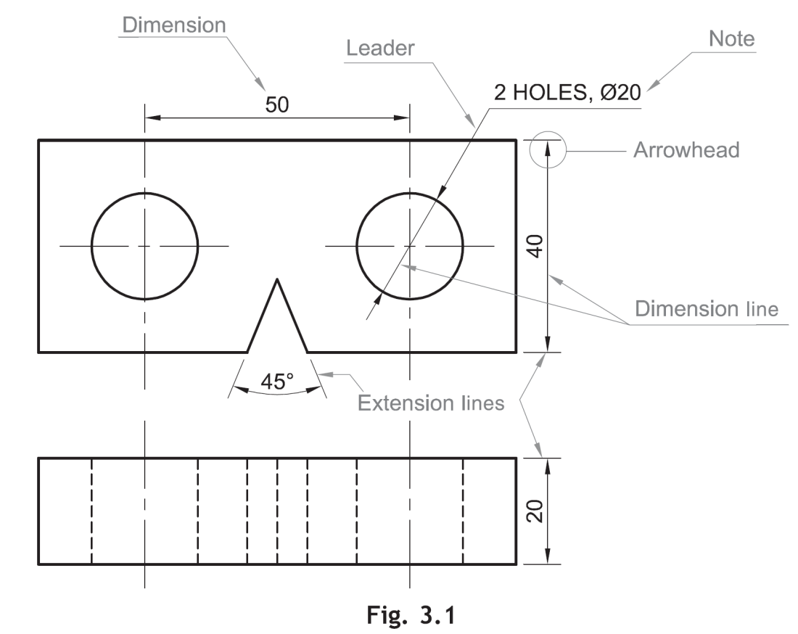
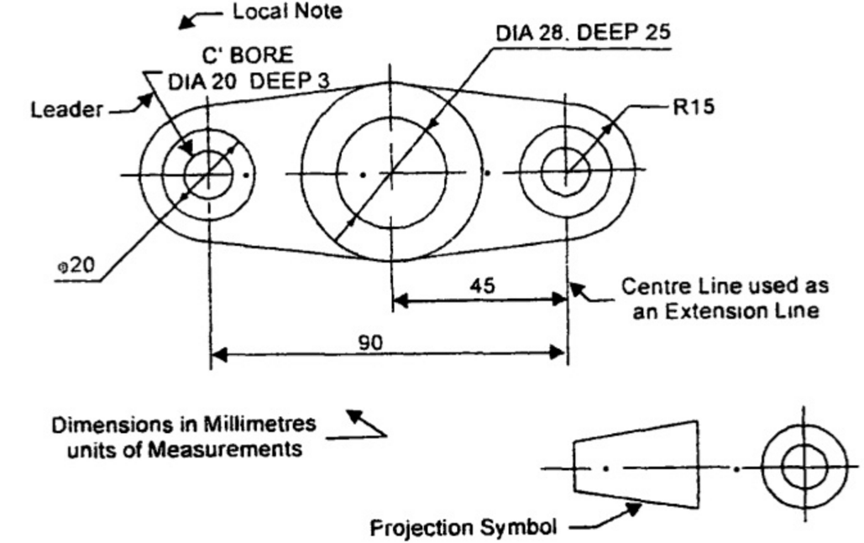
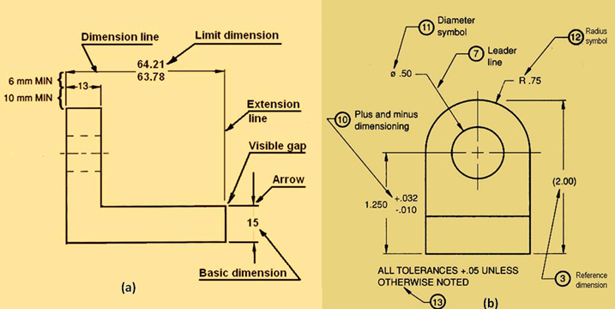
Examples for elements of dimensioning
Elements of dimensioning | Definition
Object line | A line on the drawing whose length is to be shown is called an object line. In case of angles 2 lines forming angle will be object lines.
Extension line | An extension line is a thin continuous line drawn perpendicular to an object line. It extends by about 3 mm beyond the dimension line
Dimension line | Dimension line is drawn between 2 extension lines parallel to the object line. One dimension line represents one dimension. For angles a curved dimension line as arc with center at the vertex of angle is drawn. It is terminated by arrowheads touching the extension lines
Center line | A center-line is a thin, dark line alternating long and short dashes. Center-lines are commonly used as extension lines in locating holes and other symmetrical features. When extended for dimensioning. Center-lines cross over other lines of the drawing without gaps. Always end center-lines using a long dash.

Slide 11
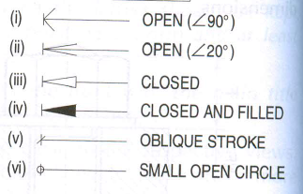
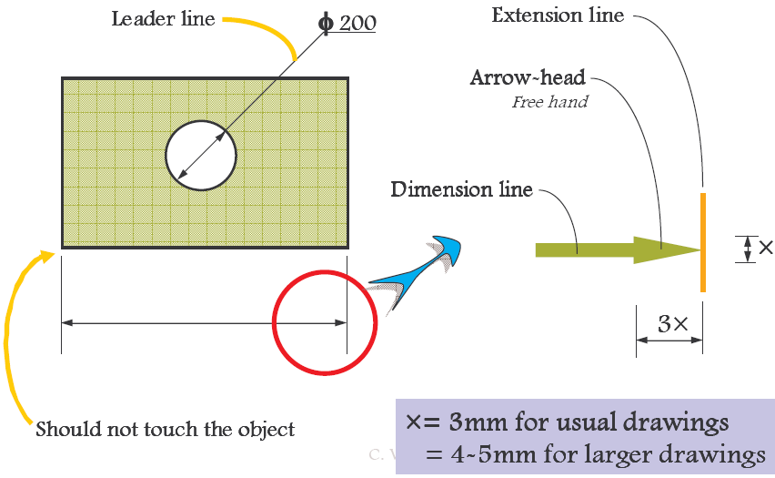
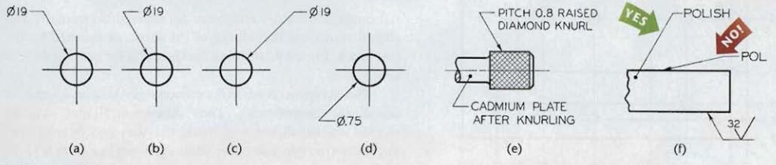
Elements of dimensioning | Definition
Leader line | A leader or a pointer is a thin continuous line connecting a note or a dimension figure with the feature to which it applies. Never drawn vertical of horizontal but at some angle. A dot is used instead of an arrowhead if the leader ends inside the object.
Arrowheads | An arrowhead is placed at each end of a dimension line. Its pointed end touches an extension line. The size of an arrowhead should be proportional to the length of the dimension line. The length of the arrowhead should be about three times its maximum width.
Dimension | Placed near the middle and above the dimension lines or at the center of dimension lines by breaking them. As all dimensions of a drawing are in the same unit, instead of unit a note (ALL DIMENSIONS IN MM) preferable at the left hand side of title block is written. Dimension text should be uniform for all features.

Slide 12
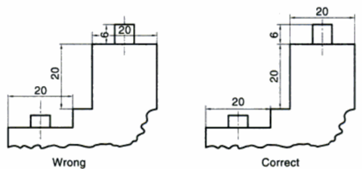
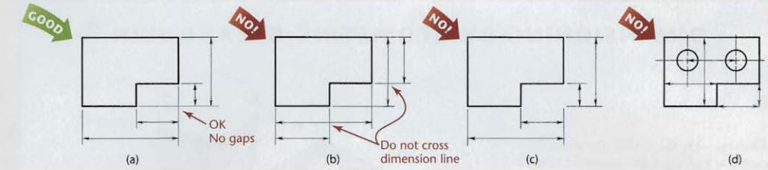
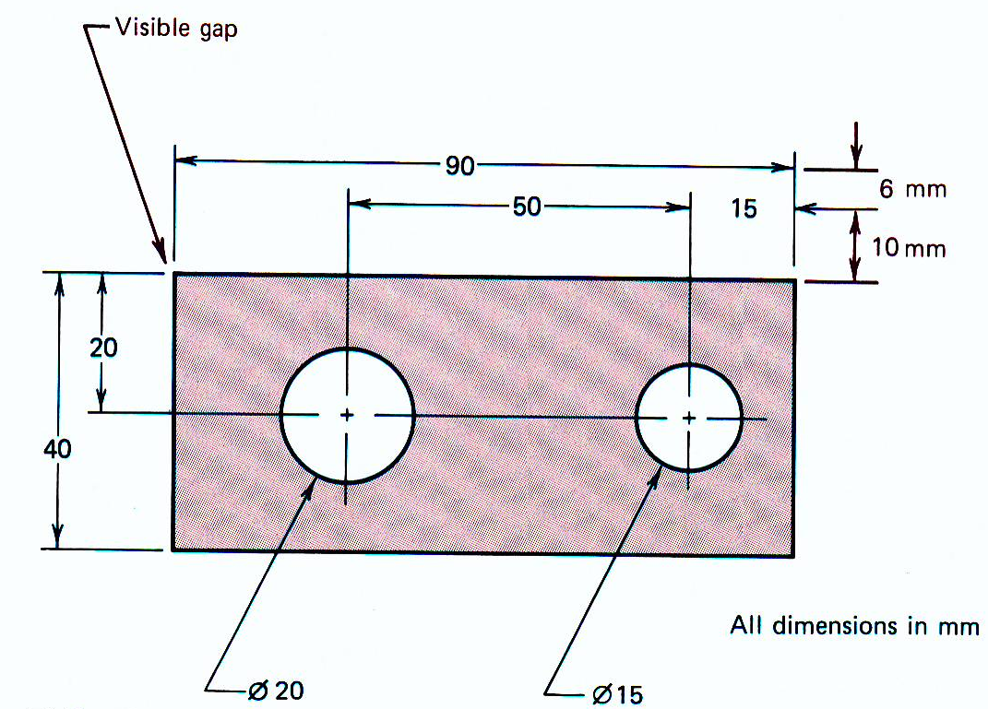
Best practices for dimension & extension lines
The shorter dimensions are nearest to the object outline.
Dimension lines should not cross extension lines as in Figure (b), which results from placing the shorter dimensions outside. Note that it is perfectly satisfactory to cross extension lines (Figure a), but they should not be shortened (Figure c).
Dimension lines should not cross each other & any other lines of the object. However extension lines can cross both (fig 1).
A dimension line should never coincide with or extend from any line of the drawing (Figure d).
Fig 1

Slide 13
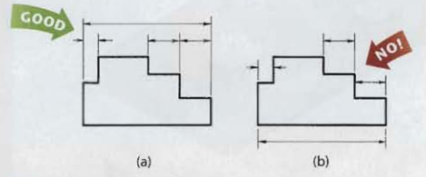
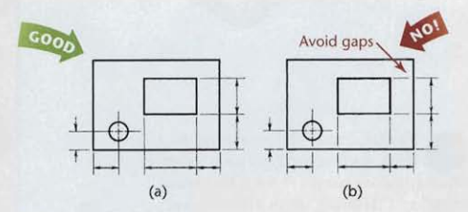
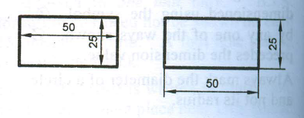
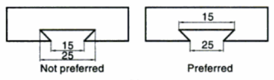
Best practices for dimension & extension lines
Dimensions should be lined up and grouped together as much as possible, as in Figure 2a, and not as in Figure 2b.
In some cases, extension lines and center-lines must cross visible lines of the object (Figure 3a). When this occurs, gaps should not be left in the lines (Figure 3b).
Fig 2
Fig 3
Dimensions should be placed outside the views (a). Placed inside if more clear and readable (b).

Slide 14
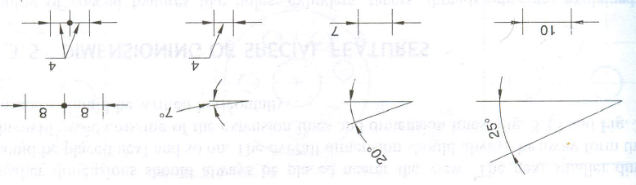
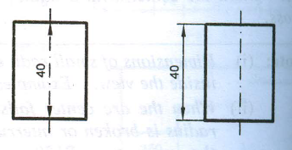
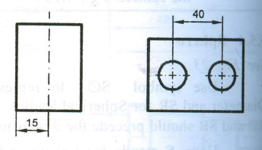
Best practices for arrowheads & centerlines
Arrowheads should ordinarily be drawn within the limits of the dimensioned feature. But when the space is too narrow, they may be placed outside (fig 4)
Fig 4
Fig 5a
Center line(axis) itself shall not be used as a dimension line with arrowheads as its ends. Fig 5a
Center line(axis) itself shall not be used as a dimension line with arrowheads as its ends. Fig 5b
Fig 5b
Center-lines should not extend from view to view.

Slide 15
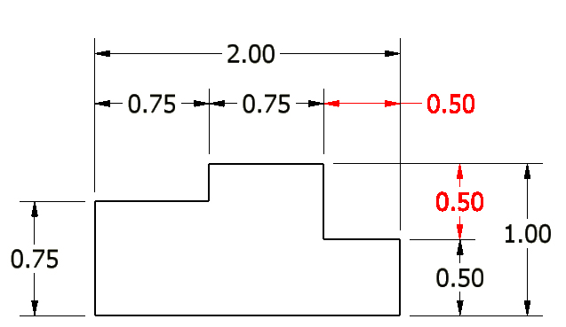
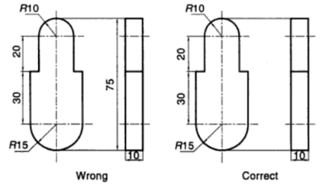
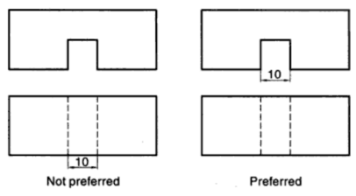
Best practices for dimensions
All dimensions must be given. There should not be need for calculation, assumption or direct measurement for any dimension. Dimension should be on feature’s best view.
Each dimension should be given only once. No dimension should be redundant / superfluous (repeated) (fig 6). Not even on another view (fig 7) or by different ways.
Fig 6
Fig 7
Dimensions shall be given to visible lines and not to hidden lines
Each feature is dimensioned and positioned where its shape shows.
Fig 1
Fig 2

Slide 16
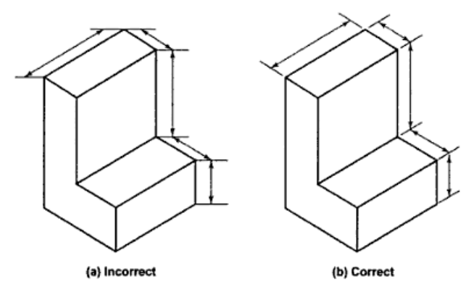
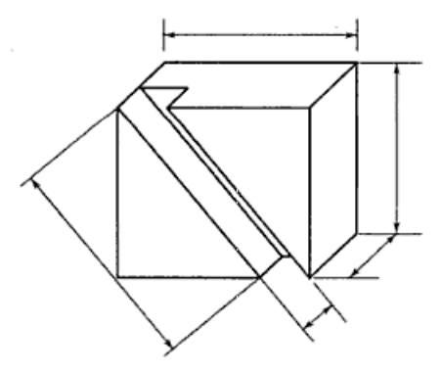
Best practices for dimensioning pictorial view
Principal lines are dimensioned in pictorial view. Dimension and extension lines are drawn in directions that are parallel to the principal lines. For non-principal lines, its coordinates, in the direction parallel to the principal lines are given. (fig L)
Fig 1
Fig L
Fig R
In case of oblique parallel projections, along with principal lines, those lines which are projected with true length are also dimensioned. In those cases, extension lines are drawn perpendicular to dimension lines. (fig R)

Slide 17
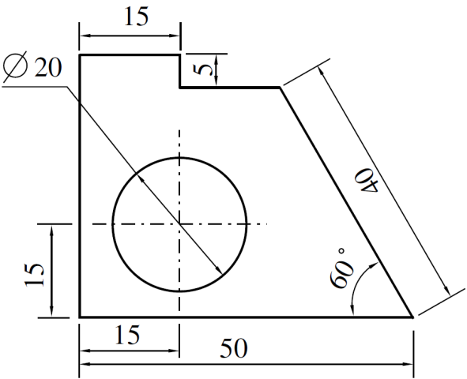
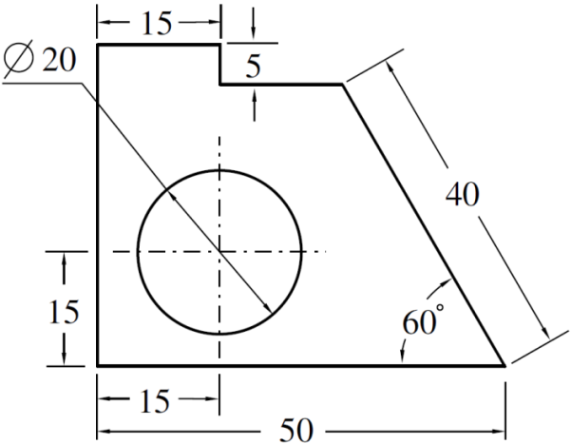
Systems of dimensioning
For placing the dimensions on the drawing, following systems can be adopted.
Aligned system | Unidirectional system
Dimensions are placed perpendicular to the dimension line. Horizontal and inclined dimensions can be read from the bottom of the drawing. Vertical dimensions can be read from the right-hand side of the drawing. All dimensions are placed above the midpoint of dimension lines. | Dimensions are placed vertically irrespective of dimension lines. All dimensions can be read from the bottom of the drawing. Horizontal dimensions are placed above the midpoint of dimension lines. Vertical and inclined dimensions are placed at the middle of dimension lines by breaking them.
Note
All the dimensions on a drawing must be shown using either Aligned System or Unidirectional System. Two systems should not be mixed on the same drawing.

Slide 18
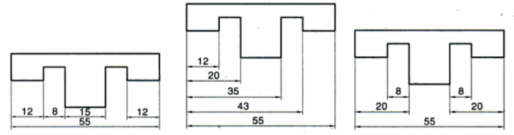
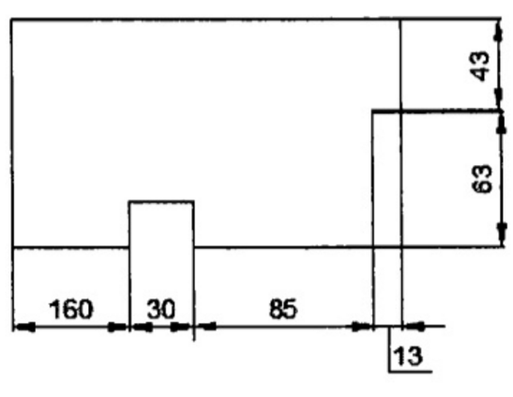
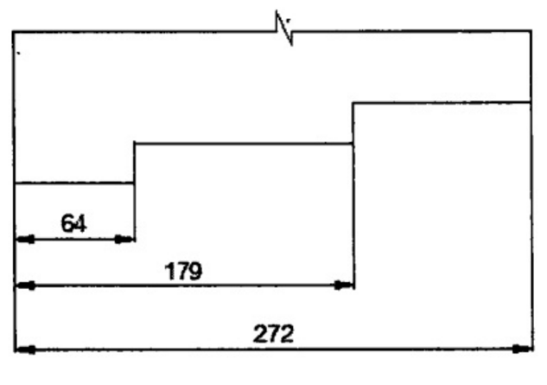
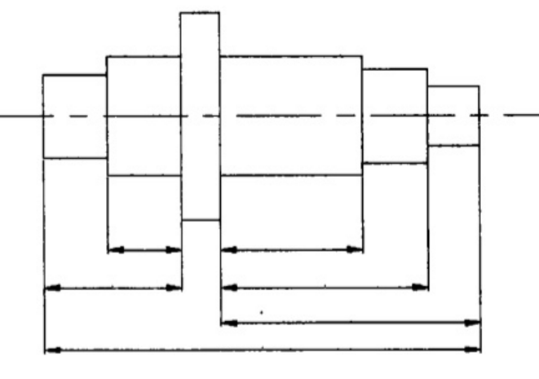
Arrangement of dimensions
Chain dimensioning | Parallel dimensioning | Combined dimensioning
All dimensions are aligned in such a way that an arrowhead of one dimension touches tip-to-tip the arrowhead of adjacent dimension. The overall dimension is placed outside the other smaller dimensions. | All dimensions are shown from a common reference line. All dimensions share a common extension line. This is adopted when dimensions have to be established from a particular datum surface. | Both the methods (chain & parallel) are used on the same drawing
Used when the possible accumulation of tolerances does not endanger the fundamental requirement of the component. | Used where a number of dimensions have a common datum feature

Slide 19
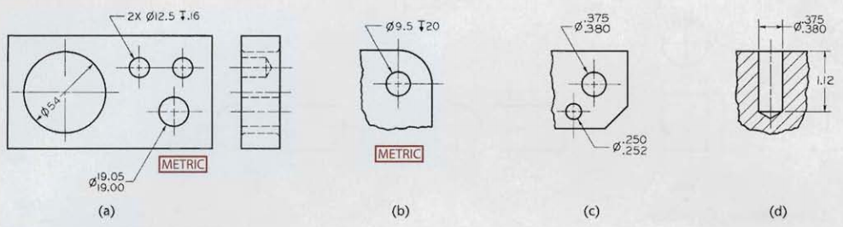
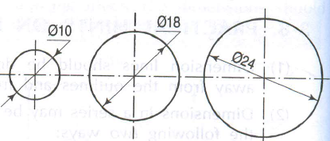
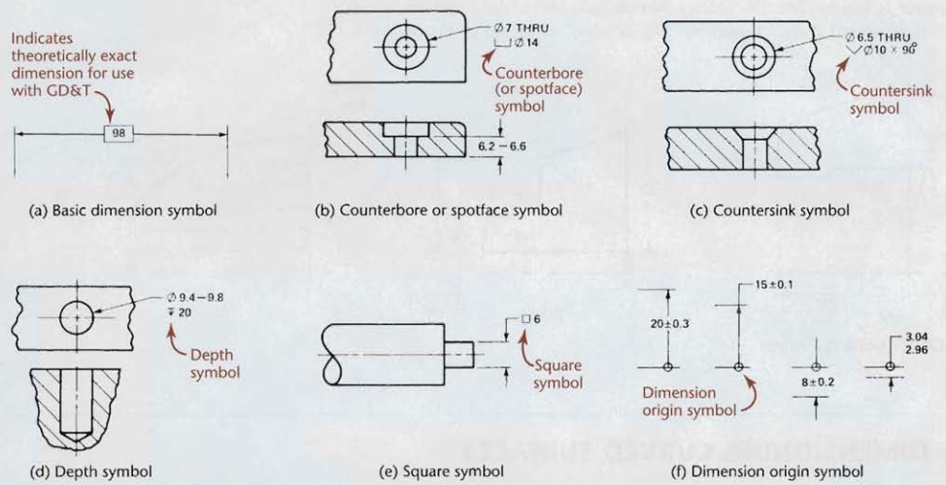
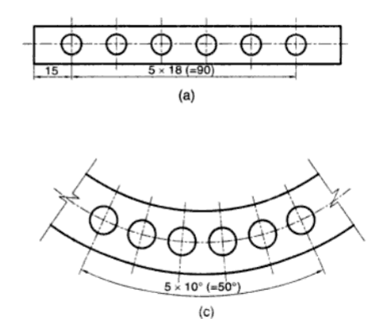
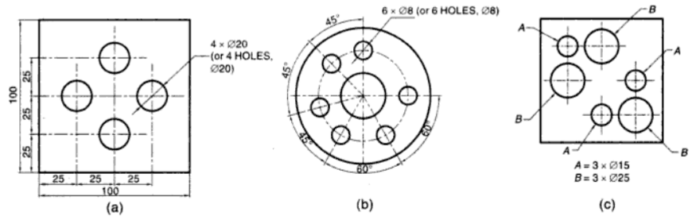
Dimensioning of circular features
By diameter instead of radius, precede by Ø symbol, leaders.
For more than 1 hole of same Ø, the dim. of a hole with a note will give idea about the dimensions of all the holes. (fig 8a,b)
Hole dimensioning
If there are different categories (each with same Ø holes) of holes, use reference letters and noted below the view. (fig 8b)
Standard symbols for dimensions
Fig 9
Fig 8
Equispaced holes (fig 9) where 5x18 means 6 holes center-to-center distance 18mm

Slide 20
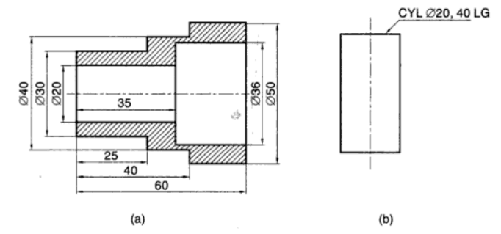
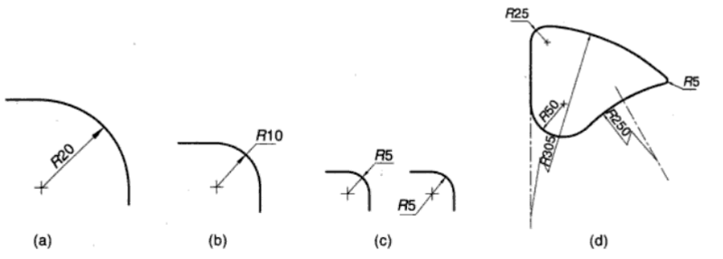
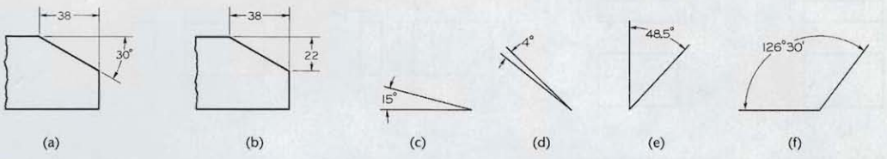
Dimensioning of arc, fillets, angles & cyl.
Arc shown by radius, precede by R symbol, center marked by cross, leaders. For large or small arc, center mark is omitted (10)
Cyl. dimensioning
Fig 10
Angle dimensioning
Fillets are of standard size, such as metric R3 and R6. Thus, a note in the or simply lower portion of the drawing is given.
FILLETS R6 AND ROUNDS R3 UNLESS OTHERWISE SPECIFIED or
ALL CASTING RADII R6 UNLESS NOTED or
ALL FILLETS AND ROUNDS R6.

Slide 21
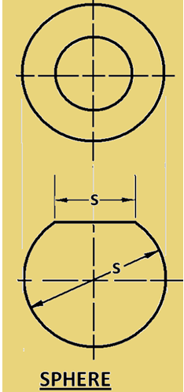
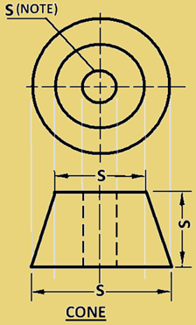
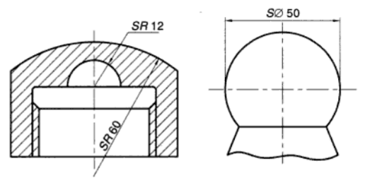


Dimensioning of spherical, conical, tapered
Spherical feature dimensioning
Conical feature dimensioning
Flat tapered feature dimensioning

Slide 22





Dimensioning- square, chamfered, countersunk
Square feature dimensioning
External Chamfer dimensioning
Countersunk dimensioning
Internal Chamfer dimensioning

Slide 23









Dimensioning- screw threads
Metric thread
Nominal dia. = 12mm
Depth of drilled hole = 22mm
Threaded length = 18mm
External thread
Internal thread
Symbols & abbreviations used in dimensioning

